Slide 1

BACHELOR OF SCIENCE IN MATHEMATICS
DEPARTMENT OF MATHEMATICS
GOVERNMENT ARTS AND SCIENCE COLLEGE
THENNANGUR-604408
OCTOBER-2023
This Photo by Unknown author is licensed under CC BY-SA.

Slide 2

UNVEILING MARKET INSIGHTS
TEAM LEADER:
S.ANUSUYA
TEAM MEMBERS:
E.HEMALATHA
R.PAVITHRA
S.DHANASEKARAN
OUR MENTOR:
MR.R.SUDHAGAR
DEPARTMENT OF MATHEMATICS

Slide 3

UNVEILING MARKET INSIGHTS

Slide 4

INTRODUCTION:
Thus involves delving into valuable information and trends that drive business decisions.by analyzing market data, businesses gain a deeper understanding of consumer behavior, industry dynamics, and competitive landscapes.
This knowledge empowers companies to make informed strategic choices, innovate effectively, and stay ahead in the rapidly changing market.

Slide 5

OVERVIEW:
An overview of market insights provides a broad perspective on the process of gathering, analyzing, and interpreting data related to a specific market or industry. This analysis includes understanding consumer preferences, market trends, competitor strategies, and other factors influencing the market. Market insights help businesses identify opportunities, mitigate risks, and develop strategies to enhance their competitive advantage.

Slide 6

PURPOSE:
The purpose of market insights is multifaceted. Here are a few key aspects of its purpose:
Informed Decision Making
Understanding Customer Needs
Competitive Advantage
Risk Mitigation
Strategic Planning
Maximizing Opportunities

Slide 7
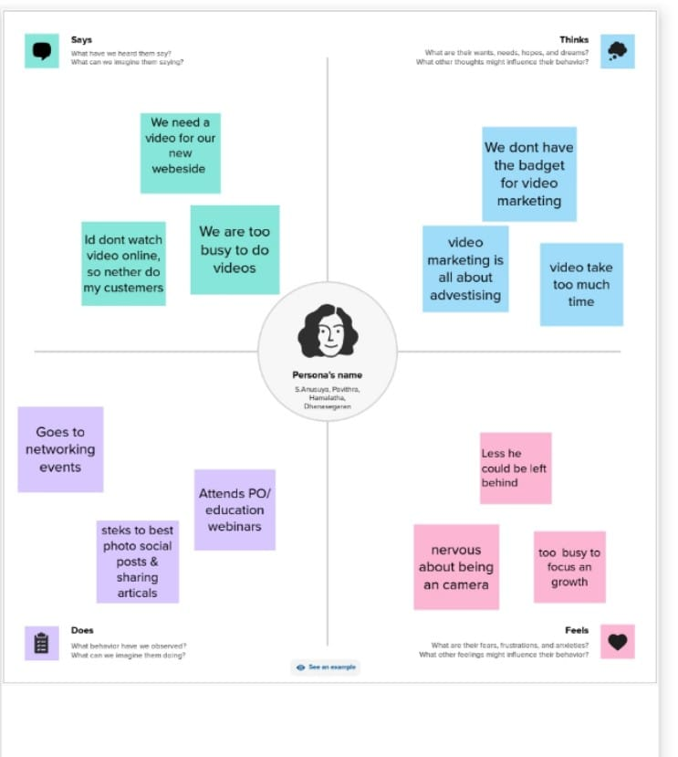
EMPATHEY MAP

Slide 8
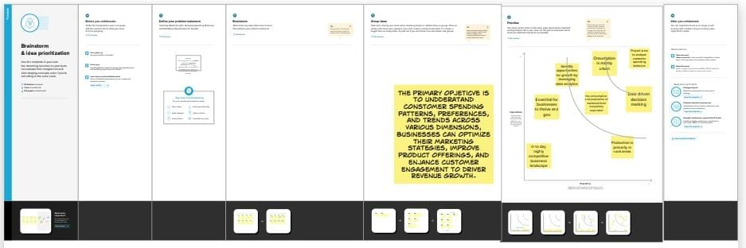
BRAISTORING:

Slide 9
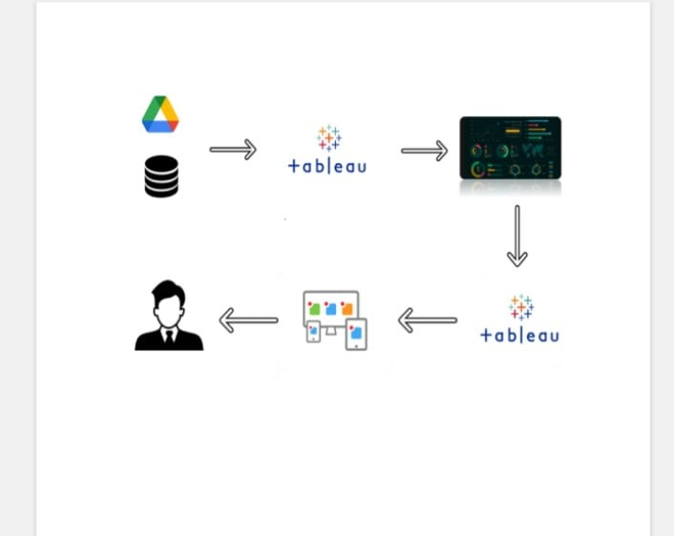
TECHNICAL ARCHITECTURE:

Slide 10

VISUALIZATIONS

Slide 11

Milk Kpi:

Slide 12
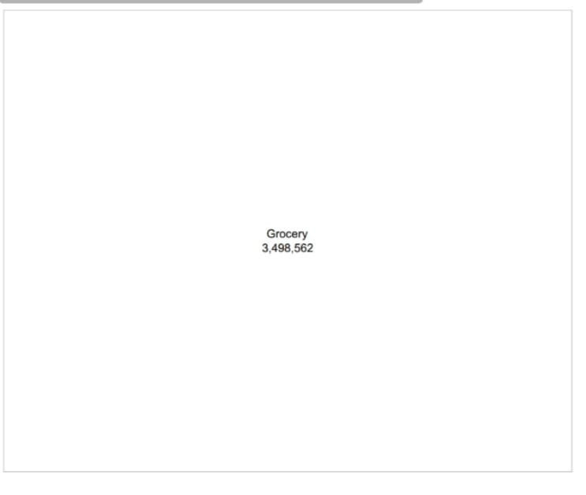
Grocery Kpi:

Slide 13
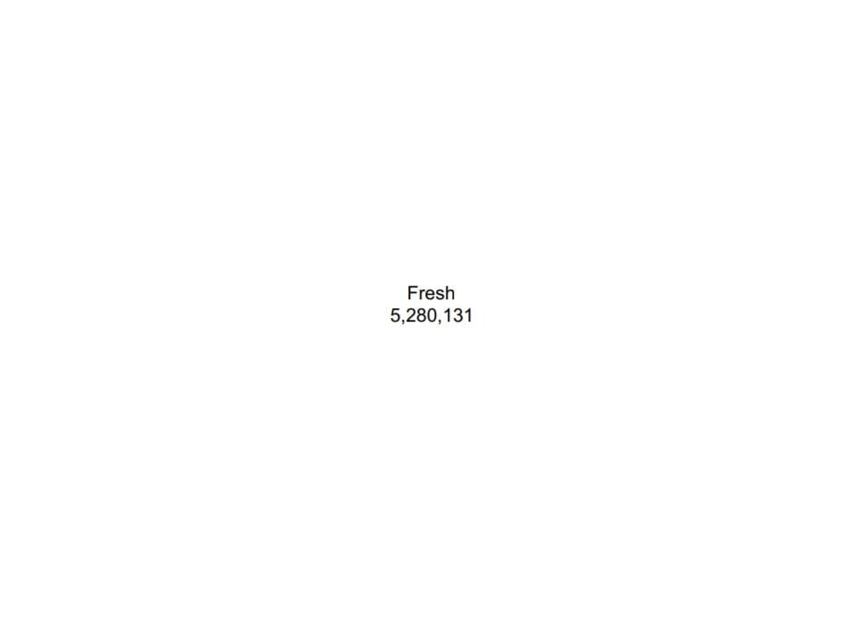
Fresh Kpi:

Slide 14
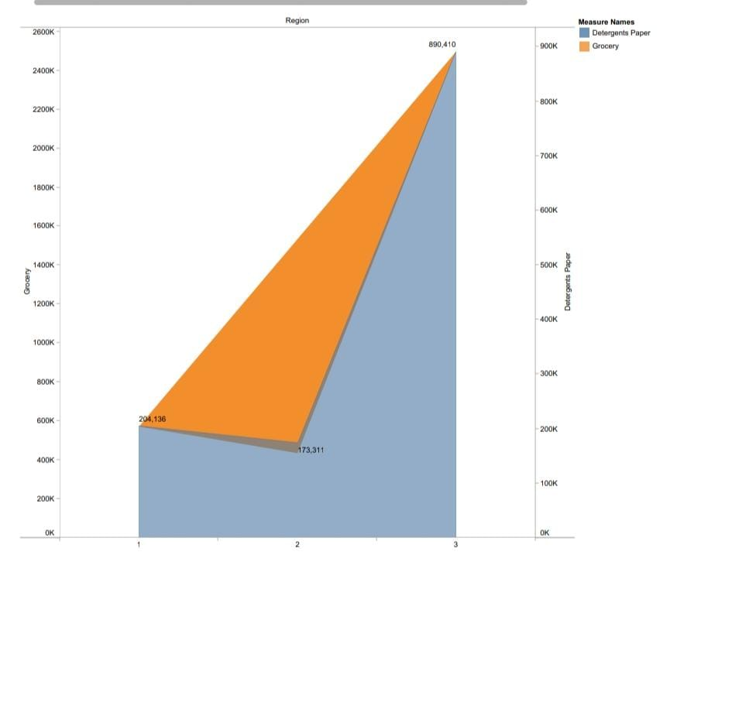
Region Wise Detergent Paper And Grocery:

Slide 15
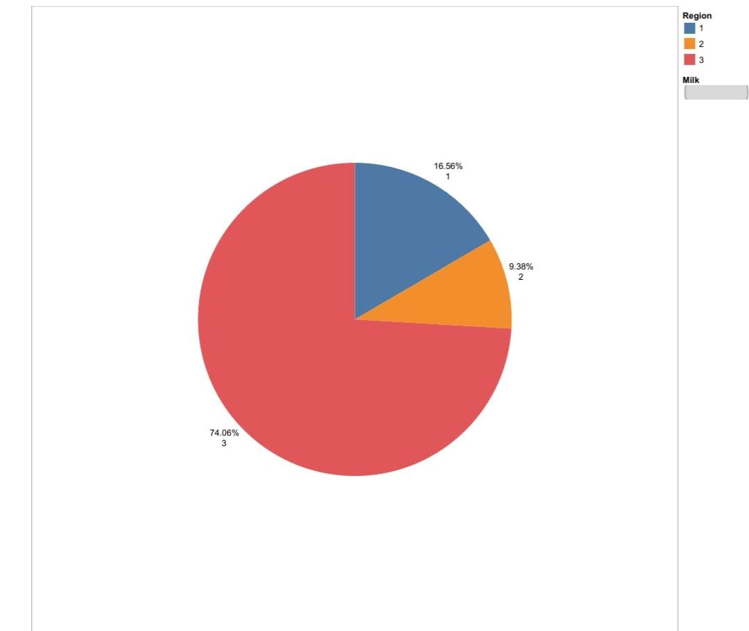
Region Wise Milk:

Slide 16
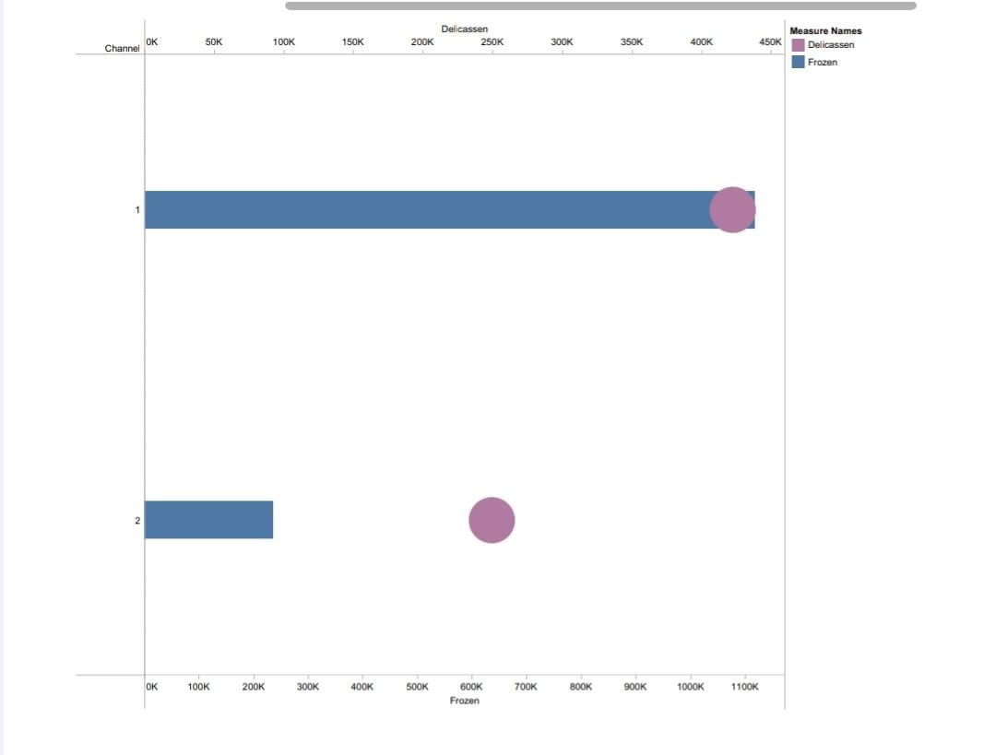
Channel Wise Delicassen And Frozen:

Slide 17
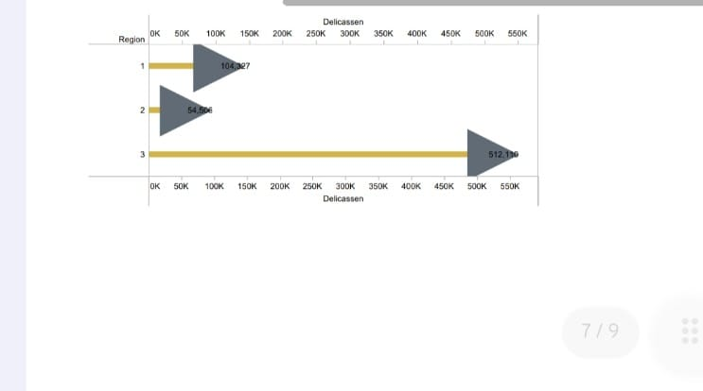
Region Wise Delicassen

Slide 18
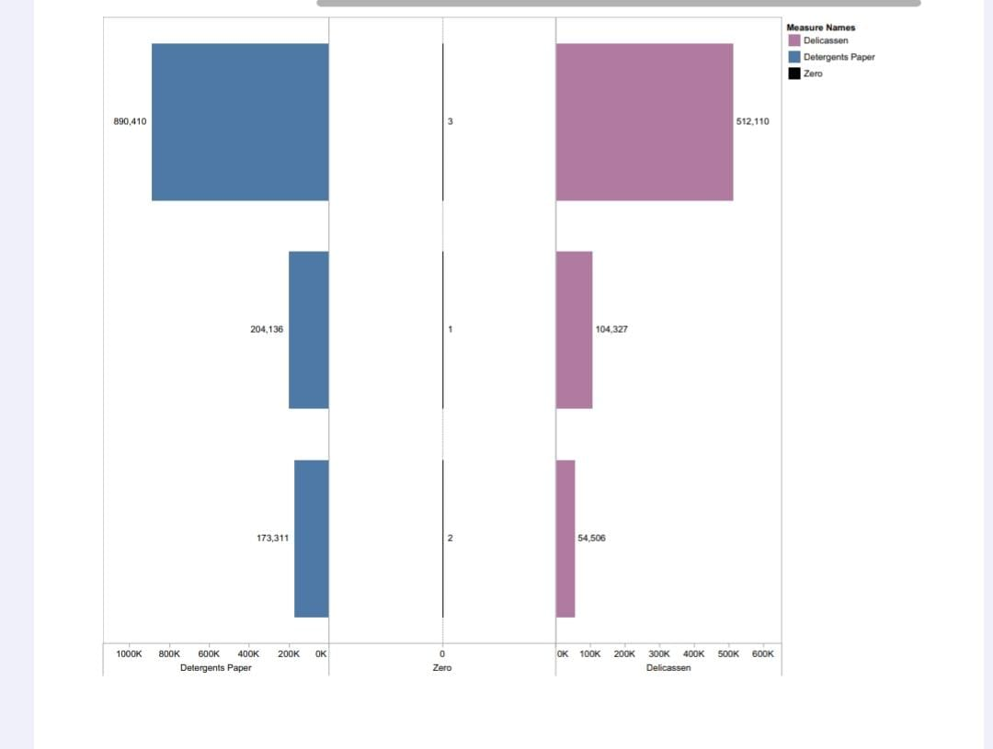
Region Wise Delicassen and Detergent Paper

Slide 19

Dashboard

Slide 20
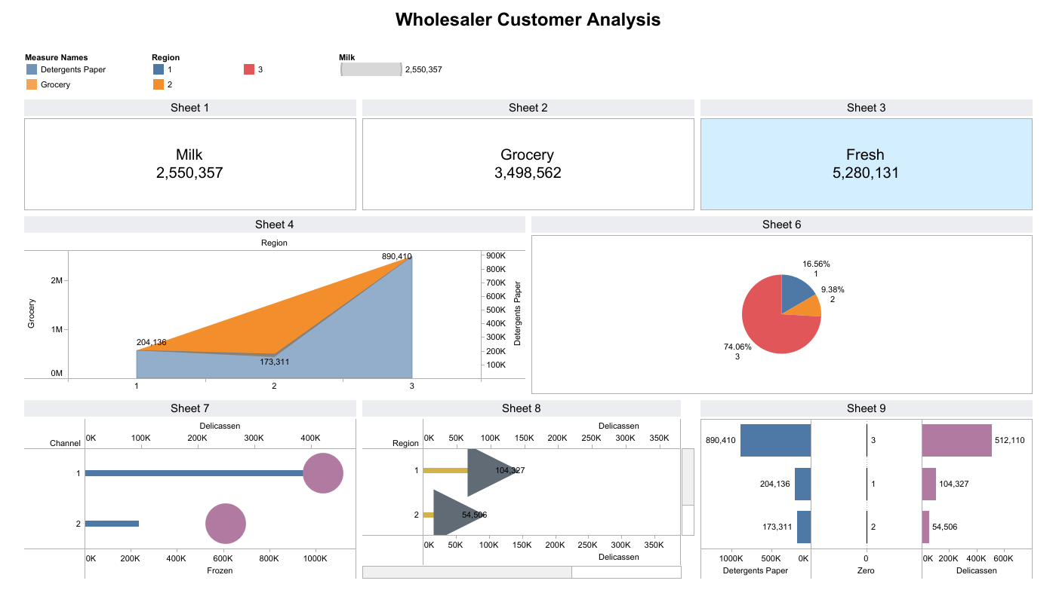
Dashboard

Slide 21

Story:

Slide 22
STORY

Slide 23
ADVANTAGES AND DISADVANTAGES
ADVANTAGES
DISADVANTAGES
Informed Decision Making: Market insights empower businesses to make data-driven decisions, increasing the likelihood of success.
Competitive Edge: Understanding market trends and consumer behavior helps companies stay ahead of competitors by offering innovative products and services.
Costly: Gathering comprehensive market insights can be expensive, especially for small businesses with limited budgets.
Data Accuracy: Market data might not always be accurate, leading to flawed analysis and potentially misguided decisions.

Slide 24

APPLICATIONS:
Tableau Can Be Used For Enable The Business To Function.
Delivered Product Or Services And Pursue Growth Opportunity

Slide 25

CONCLUSION:
market insights are invaluable assets for businesses, offering a wealth of information that can shape strategic decisions, enhance customer satisfaction, and foster innovation.
By leveraging these insights, businesses can gain a competitive edge, identify opportunities, and mitigate risks effectively.

Slide 26

FUTURE SCOPE:
The future scope of market insights is promising, driven by advancements in technology and evolving consumer behaviors. Here are some key areas where market insights are likely to play a crucial role in the future:

Slide 27


This Photo by Unknown author is licensed under CC BY-NC.

